Slide 1
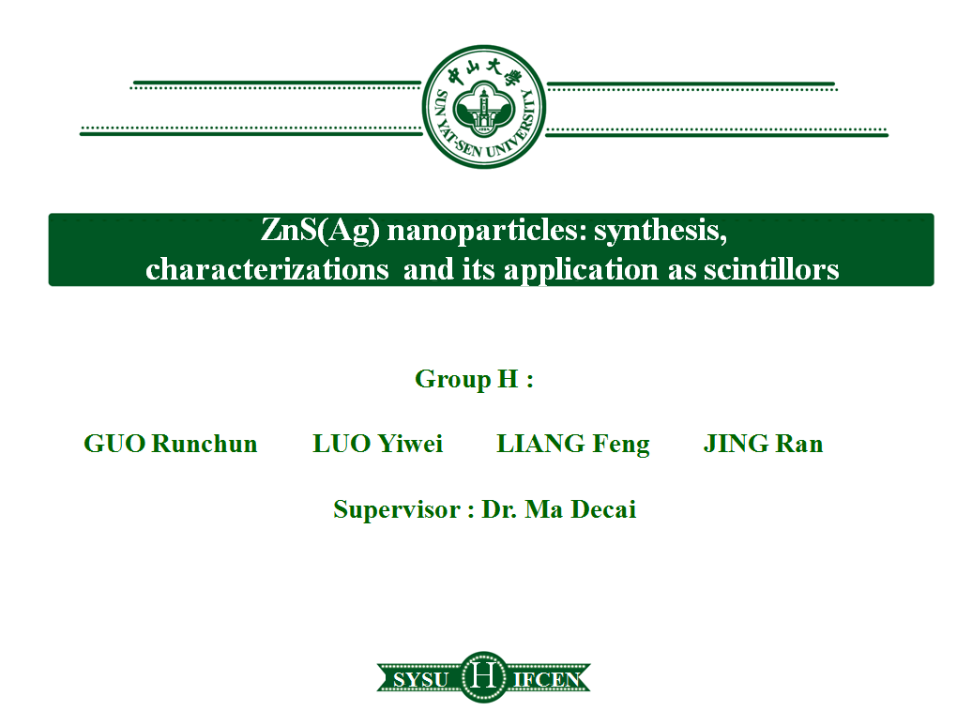
Gait planning of the Hexapod robot working for Nuclear Power Plant Emergency Environment
Supervisor: LIU YANG
Group member: FENG Xuebin (Lambert)
HE Lemin (Salomé)
LU Shengbo (Édouard)
19
Notes:
打招呼 （很高兴。。。） 介绍组员 谁说哪一份部分（目录）

Slide 2
Context
Part 1-------------------------Introduction
Part 2------------------------- Gait planning
Part 3------------------------- Trajectory planning for obstacles crossing
Part 4------------------------- Path planning

Slide 3
Part 1
Introduction

Slide 4

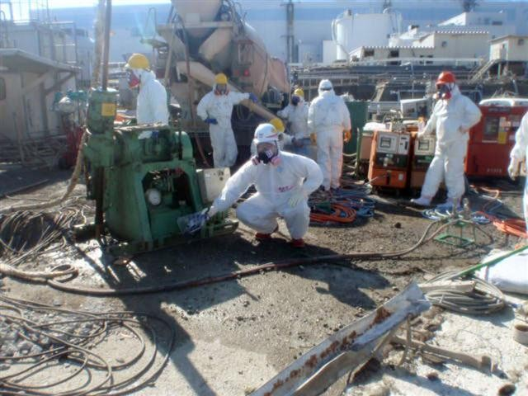
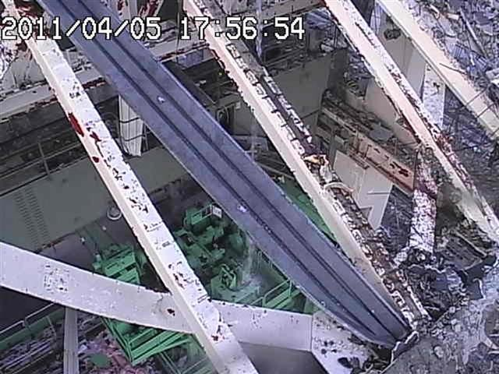
Introduction : Situation in NPP
Emergency situation in Nuclear Power Plant
High radioactivity
Roughness of the ground
Photos of Fudao NPP after the accident in 2011
Notes:
核电站机器人的应用现状，六足机器人的优势，目前机器人运动研究的重点（路径规划和步态规划独立研究），我们的目标是：结合路劲规划和步态规划一起研究，发挥六足机器人的最大优势，实现六足机器人能在核危机时候替代人进行快速安全的救援行动

Slide 5
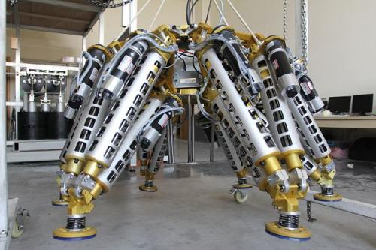
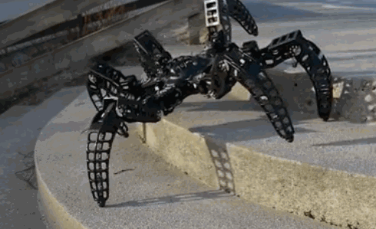
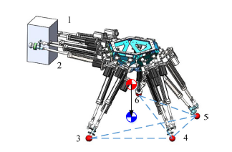
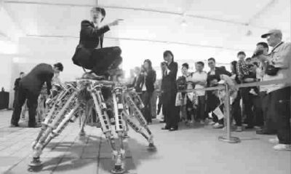
Introduction : Why do we study hexapod robot?
Object carrying hexapod robots
design by Hua Deng
MX-Phoenix design by Zenta
Heavyload robot in Shanghai jiaotong university
Omnidirectional ability
High payload ability
High robustness
Notes:
改成图对应不同的特性，一页字体不超过三种，颜色一样。 Introduction！

Slide 6
Introduction : Review of gait planning
1999
JIN has proposed an adaptive gait planning for searching the avaliable foothold during the movement
J.M Porte has proposed a priority control method in gait planning to optimize the selection of differents gait
2004
2008
WANG has proposed the CPG control system for simulating the gait movement
2009
GUO has analyzed the factors influence the output signal of CPG system
Notes:
改成图对应不同的特性，一页字体不超过三种，颜色一样。 Introduction！

Slide 7
Introduction : Review of path planning
Traditional algorithm
Intelligent algorithm
1968
1997
A* method ( HARTPE,NILSSONNJ,RAPHAELB)
Genetic algorithm
(K. Sugihara，J. Smith)
1986
2010
Potential field method (O.khatib)
Neuro-fuzzy algorithm (JOSHIMM,ZAVERIMA)
2001
2016
RRT (rapidly-exploring random tree)
( LAVALLESM,KUFFNER JR JJ)
Q-learning
(Duguleana, Mihai， Mogan, Gheorghe)
Notes:
改成图对应不同的特性，一页字体不超过三种，颜色一样。 Introduction！

Slide 8
Introduction: Main Problem
Main problem：
Separation of path planning and gait planning
Lead to the loss of advantages of the hexapod robot and waste of energy
Notes:
六足应用在核电领域——gait,path
path gait 图 continuation

Slide 9
Introduction: our work
Edouard LU
Salomé HE
Lambert FENG
Gait planning
Special gaits for obstacles crossing
Path planning
Kinematic alaysis
Basic gait
Gait generation
Energy consumption
Baizer curve
Control point selection
Special obstacle crossing method
Obstacle avoidance module
Destination approach module
Final combined module for different gaits
Notes:
分解任务

Slide 10
Part 2
Gait planning

Slide 11
Gait planning
Gait planning
Kinematic analysis
Basic gait
Gait generation
Energy consumption
Define the robot's posture and position
Build the athletic ability
Control the robot to realize different gaits
Comparasion between different gaits
Notes:
in order to control the hexapod robot's movement, it need to study the gait planning which include the kinematic analysis to define the robot's posture and position, the basic gait for building the athletic ability, the gait generation for realizing different gaits and the energy concumption compared between different gaits.

Slide 12
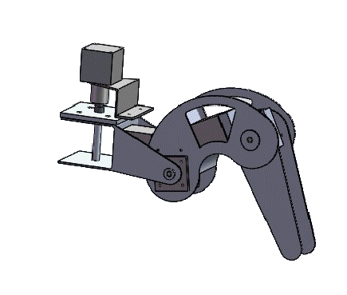
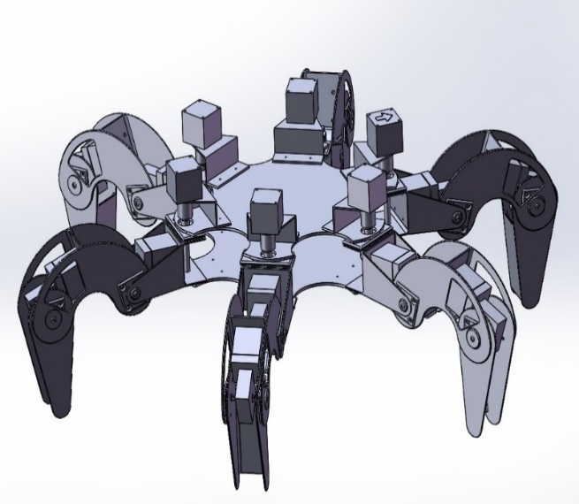
Structure of signal leg
Coxa
Knee
Ankle
Basipodite
Femur
Tibia
Notes:
现有整体机器人的结构，调辨识字号和箭头等，考虑现场观看Firstly, we should define the mecanical element of a leg. There are three joints installed in a leg, coxa joint, ankle joint and knee joint. besides, three connecting bar are basipodite, femur and tibia.

Slide 13
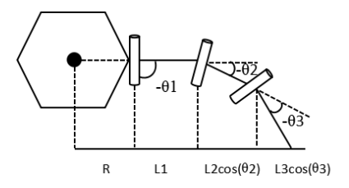
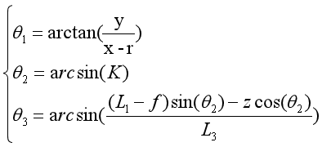
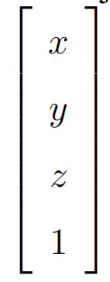
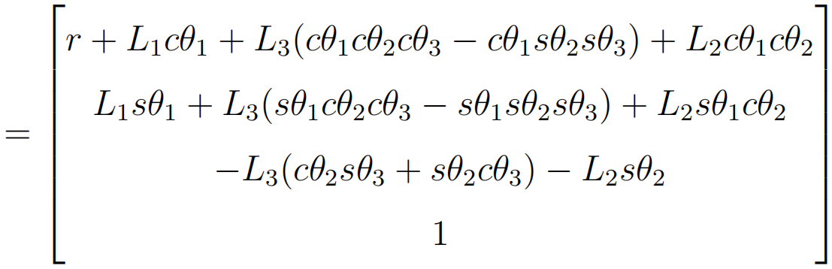
Kinematic analysis
Z₀
x₀
x₁
platform
x₂
x₃
Kinematic direct solution
Kinematic inverse solution
IF
Joint's angles are known
IF
Foot's positions are known
Calculate foot's positions in platform coordinate system
Calculate joint's angles
Notes:
有正逆解，能干嘛，In the part of kinematic analysis, we have obtained the relationship between joints' angles in each leg and the foothold positions of hexapod robot. Defining the robot's structure and the joints' angle in fig, we can solve the robot's foot position in plateform coordinate system when each joint angle are known. on the contrary, if the robot's foot position is knowm, we can solve each joint's angle in legs, which can help control the robot to accomplish different action.

Slide 14
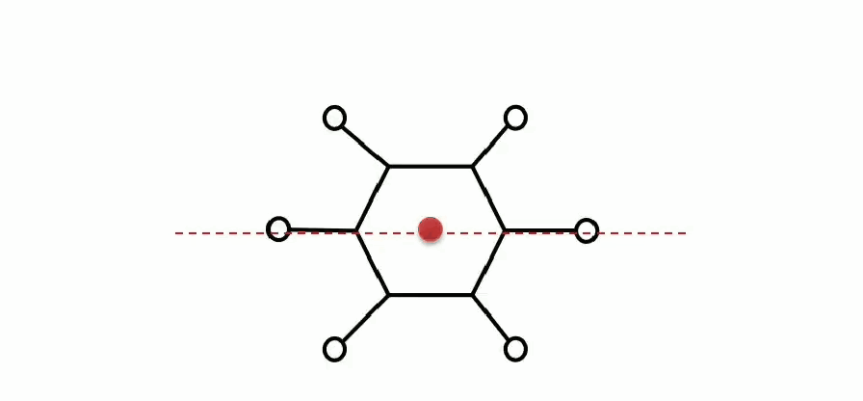
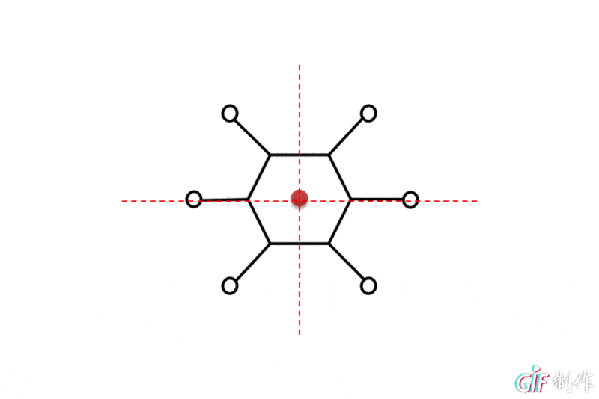
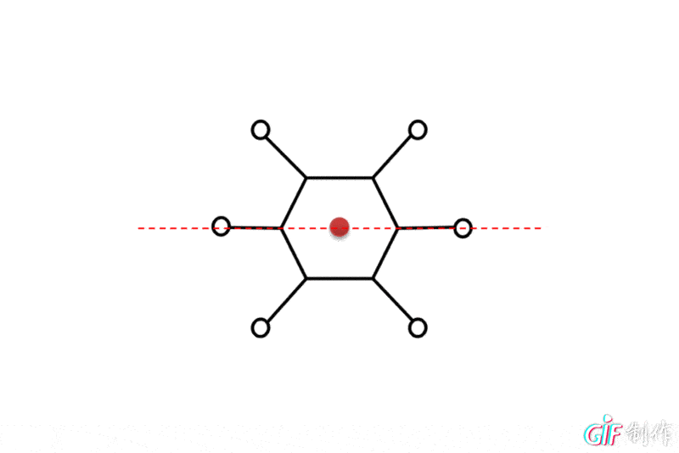


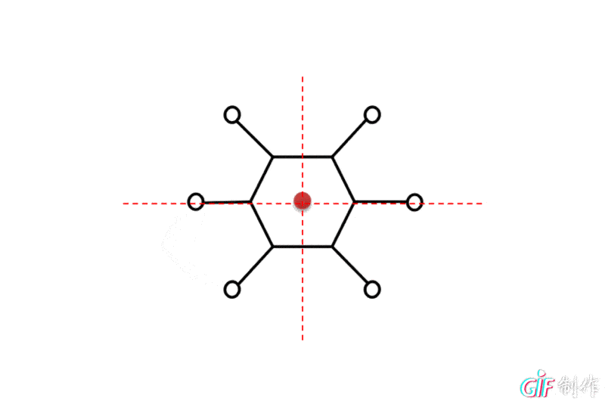
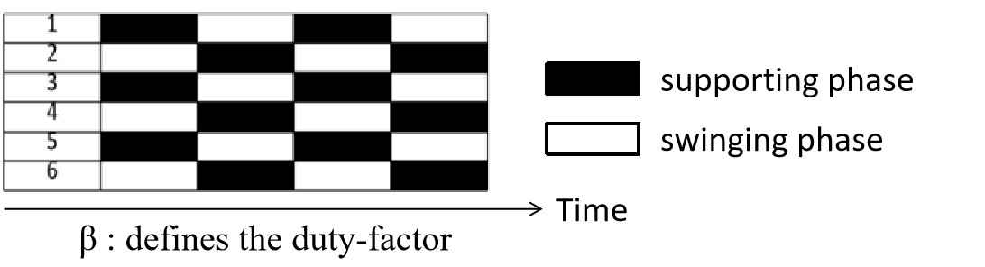
Gait types
Gait
tripod gait
crabsidle gait
quadruped gait (cross the obstacle)
quadruped gait (go up or down stairs)
one-by-one gait
turning gait
Duty factor | Step length | Velocity
1/2 |  | 0.289(L+R)
1/2 |  | 0.250(L+R)
4/5 |  | 0.115(L+R)
3/4 |  | 0.144(L+R)
5/6 |  | 0.096(L+R)
1/2 |  | 0.289(L+R)
Speciality
Higher velocity
Cross stabler
Cross faster
Higher stability
Maximum angle for a turn : 58.61°
static stability margin
Notes:
要有表述，对每个步态的分析的结论、特点！然后跟动图合并！in our work, we have analyze the characteristic of different gait and present the result in this table. we found that the tripod gait can provide a higher speed for walking while the quadruped gait help cross the obstacle. then the maximum step length of each gait is limited due to the robot's structure. in order to compare the gait characteristic, we analyze the robot's structure, the duty-factor, step length and stability margin.

Slide 15

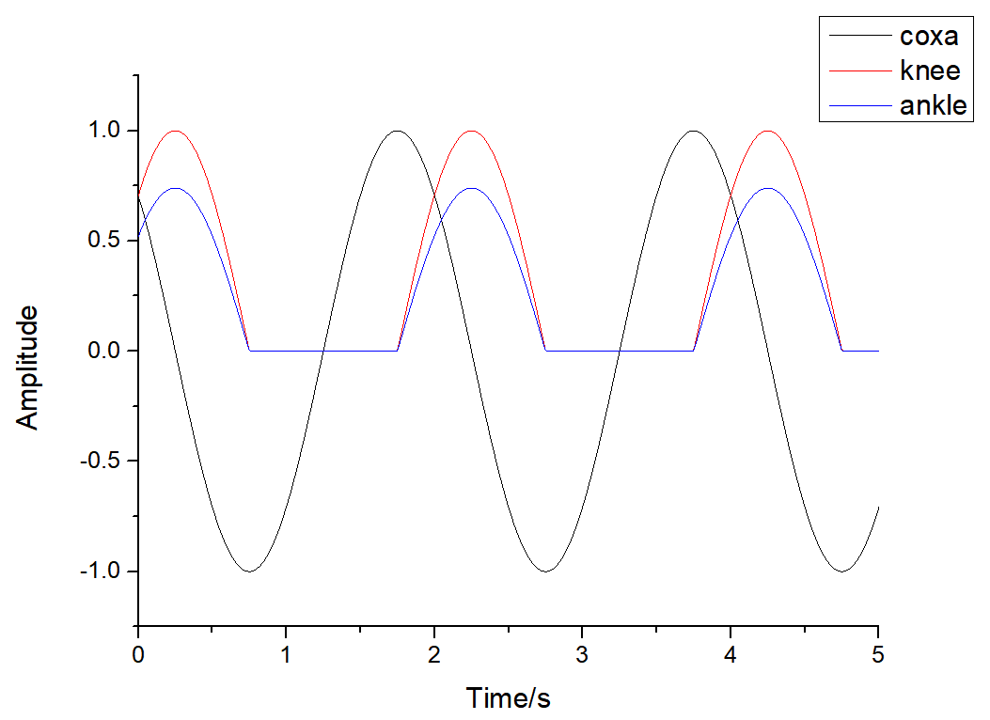
Simulation system (CPG)
CPG is a bionic control system that it can use a rhythmic signal to simulate the joint's movement in each leg, so that the central control system don't need to repeat the calculation when it do the same movement.
Coxa joint
Knee joint
lift
drop
Simplify the calculation for inverse solution at each step into two equation.
backward
forward
Notes:
4页要讲什么，有什么作用，最终结论！Each time, before the robot accomplish a gait movement, it needs to calculate the kinematic direct and inverse solution. The calculation cost much time and also energy of the Hexapod robot. So we want to find a way to simplify the procedure in gait realization.
We use the CPG bionic system to control the gait movement. CPG system can use a rhythmic signal to simulate the joint's movement in each leg, so that the central control system don't need to calculate again when it do the same movement. The CPG system runs by the oscillators so that we set six of them in each leg to control its movement.

Slide 16
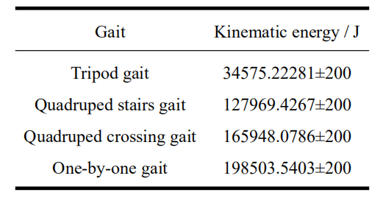
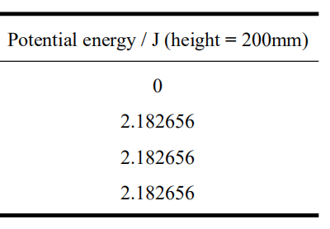
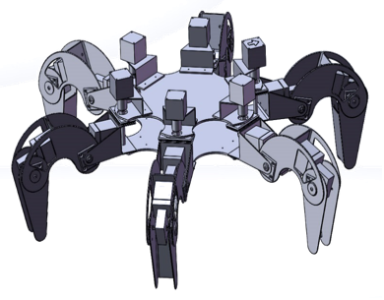
Energy consumption
Lower energy consumption method
Avoiding the obstacle
Crossing the obstacle
Notes:
突出的地方高亮！标出来having the gait's signal, we can calculate the energy variation with the discrete solution from the Hopf function mentioned before. We found that tripod gait cost less energy in a period, then quadruped stairs gait save more energy for the crossing action which is more suitable for the movement in nuclear power plant, when it need to climb the stiars.

Slide 17
Part 3
Trajectory planning for obstacles crossing

Slide 18

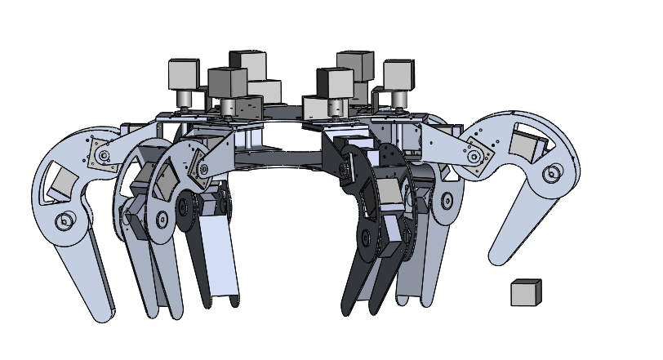
Introduction of trajectory planning
Previous part:
Basic gaits: six leg；order of movement；cooperation of six leg
In this part:
Trajectory planning：one leg; foot trajectory; obstacle crossing
Z
O
Y
Notes:
简化二维

Slide 19
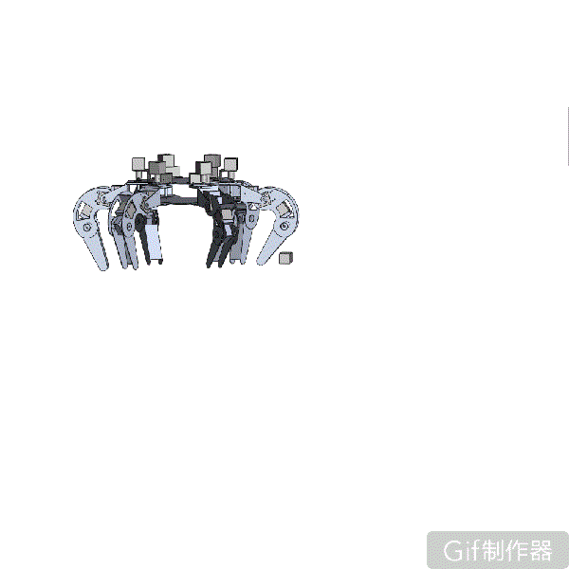
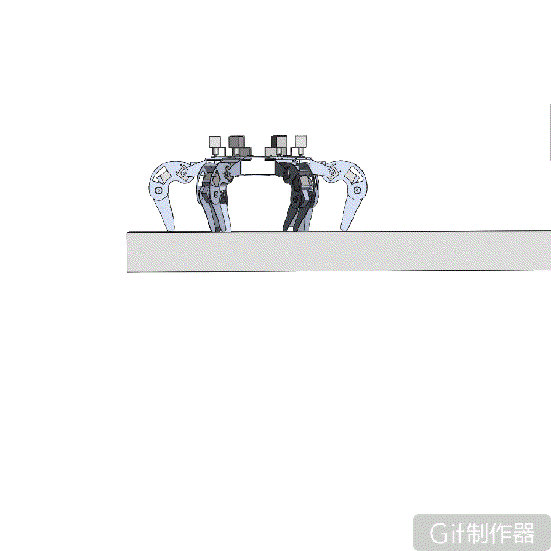
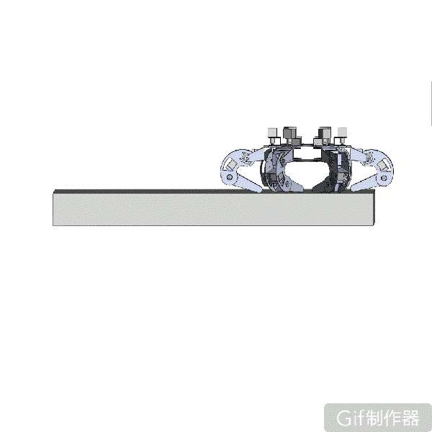
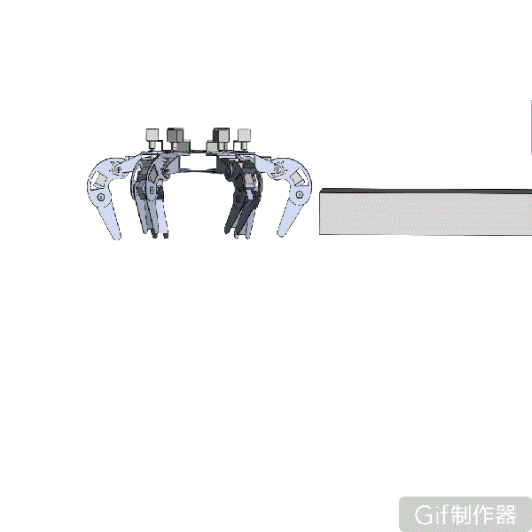
Z
Two cases of obstacle crossing
Case 1：Obstacles can be crossed in one step
O
Y
Case 2: Obstacles cannot be crossed in one step
Z
Z
Z
O
Y
O
Y
O
Y

Slide 20
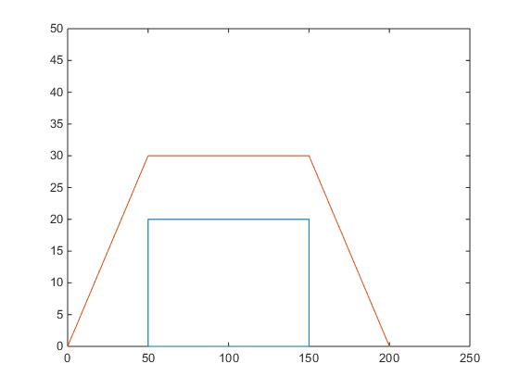
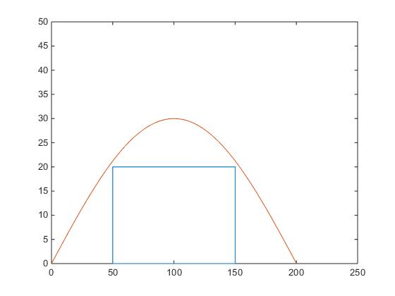
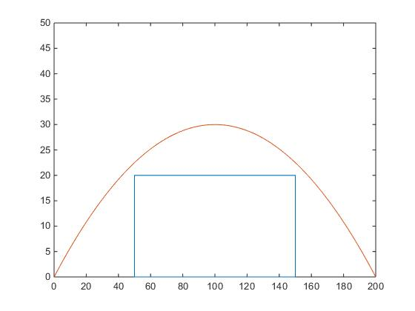
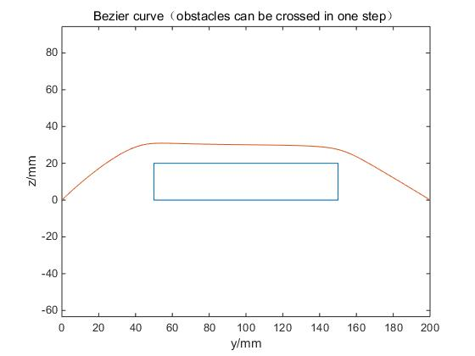
Different curves of foot trajectory
Trapezoid curve
Sine curve
O
obstacle
obstacle
Sine
Polynomial curve
Spline curve
obstacle
obstacle
Spline (Bezier curve)

Slide 21
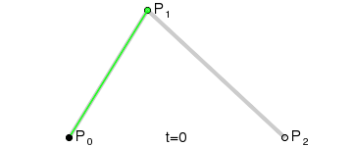
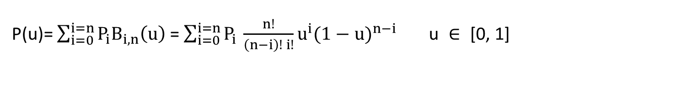
Bezier curve: definition
Expression of Bezier curve:
Control points

Slide 22
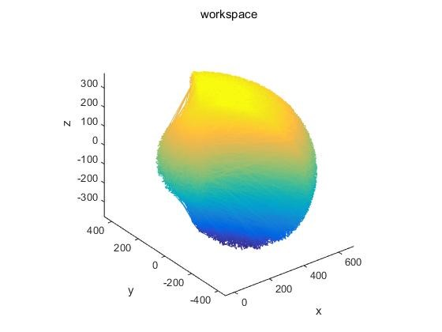
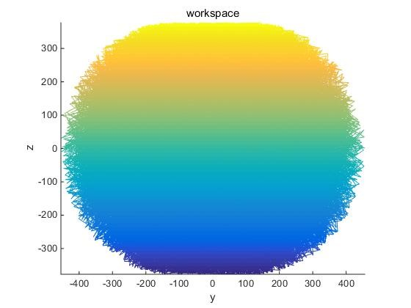
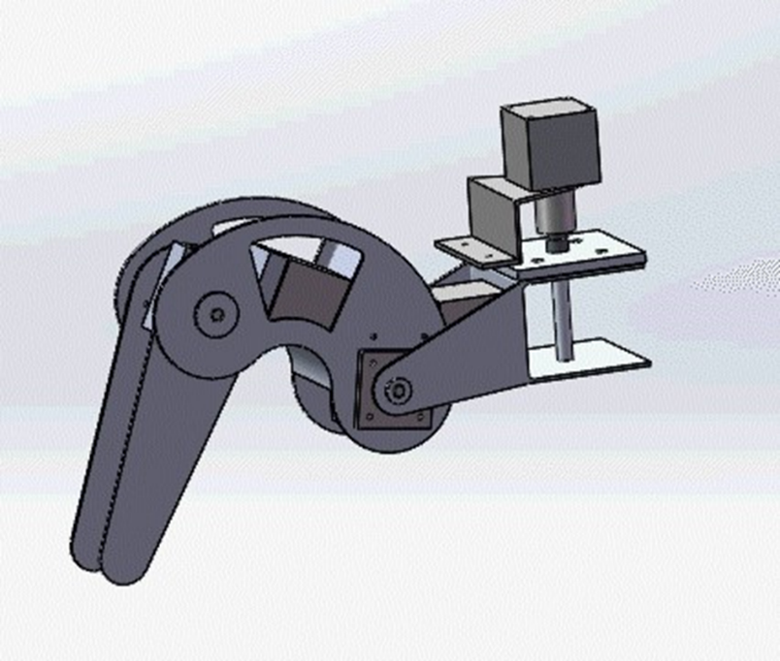
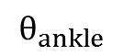
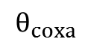
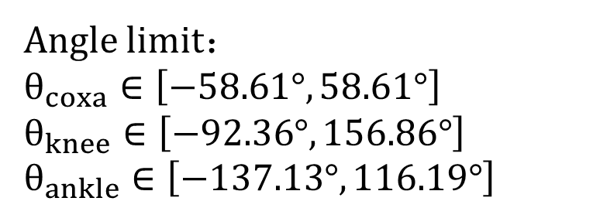
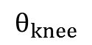
Bezier curve: Rules for selecting control points
Rule 1: Control points should be in the workspace
In y-z plan, the shape is close to a circle
When studying foot trajectory planning, we consider it as a circle with a radius of 400mm.

Slide 23
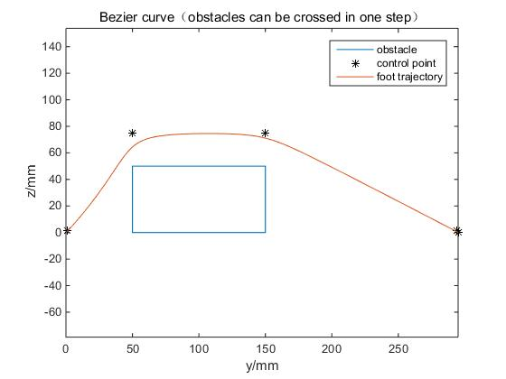
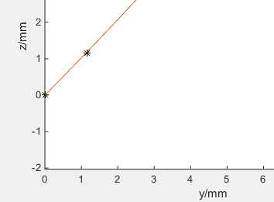
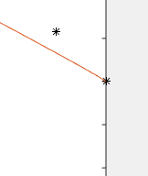

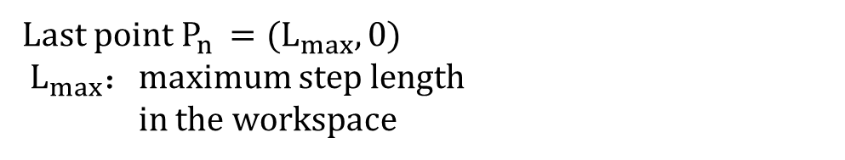
Bezier curve: Rules for selecting control points
Rule 1: Control points should be in the workspace

Slide 24
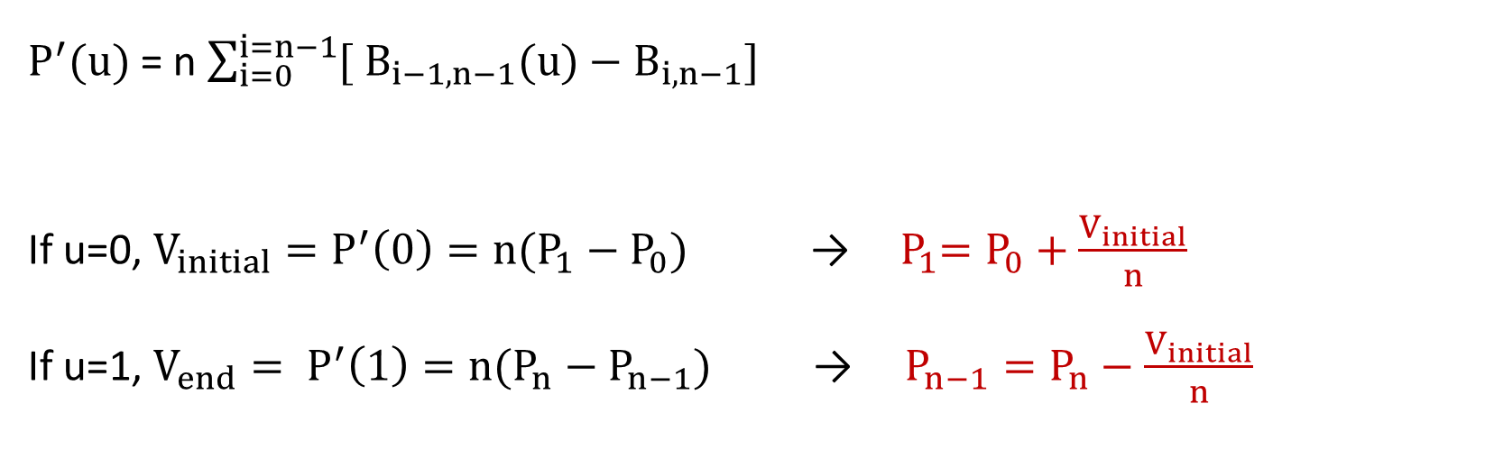
Bezier curve: Rules for selecting control points
Rule 2: Velocity boundary conditions should be satisfied

Slide 25
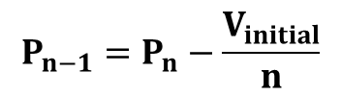
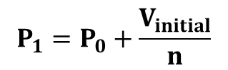
Bezier curve: Rules for selecting control points
Rule 2: Velocity boundary conditions should be satisfied

Slide 26

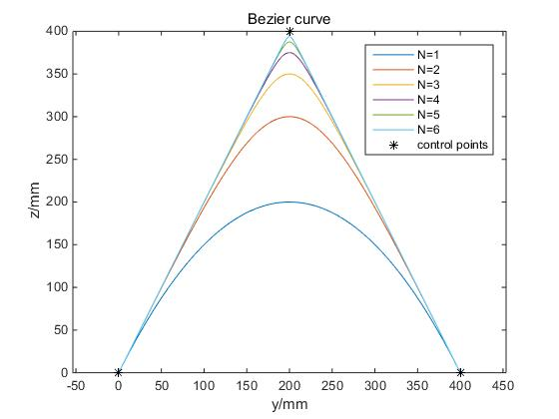
Bezier curve: Rules for selecting control points
Rule 3: Repetition of the control point
P2
N=6
N=3
N=5
N=4
N=2
N: the times of repetitions of P2
N=1
P1
P3
If we want the curve to be close to a control point
Increase the times of repetitions of the control point to five

Slide 27
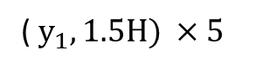
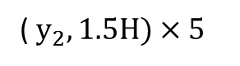
Bezier curve: Rules for selecting control points
Rule 3: Repetition of the control point

Slide 28






Bezier curve: Rules for selecting control points
Z
O
Y

Slide 29

Bezier curve → angle of each joints
Kinematic inverse solution

Slide 30






Case 2: Obstacles cannot be crossed in one step

Slide 31


Part 4
Path planning based on Q-learning

Slide 32


Path planning
Definition: Allow the robot to plan a safe route to reach the destination under some optimal objectives.
Safety: Avoid the insurmountable obstacles and cross the surmountable obstacles
Hexapod robot
Optimal objectives: Find a shortest path and always choose the correct gaits according to the ground situations
Notes:
空白太大 字号太小

Slide 33




Path planning and gait planning
Turn left or turn right
Go forward with one-by-one gait
Go forward with quadruped gait
Turn left or turn right
Go forward with tripod gait
Insurmountable obstacles
Obstacles best for one-by-one gait
start
Obstacles best for quadruped gait
Plain ground
Destination
The robot can walk safely to the destination without colliding with any of obstacles and always chooses the correct gaits according to the ground situation.

Slide 34





Path planningand gait planning
Module 1 : Avoid the obstacles
Module 2 : Approach to the destination with correct gaits
Module 3 : Combination of Module 1 and Module 2
Module 4 : Add different gaits into the combined Module 3

Slide 35


Model of Q-learning
Realization method: Q-learning
Q-learning is an algorithm of the reinforcement learning.
Agent
(Robot)
State
Reward
Action
Environment
Model of Q-learning
Notes:
线箭头

Slide 36


Introduction of Q-table
correct action
Q-table : Store the learned experience
Action
 | Action 1 go forward | Action 2 go backward
State 1 close to obstacles | 5 | 10
State 2 far from obstacles | 8 | 6
 | Action 1 go forward | Action 2 go backward
State 1 close to obstacles | 0 | 0
State 2 far from obstacles | 0 | 0
Action
State
Expected future reward
State
 | Action 1 | Action 2
State 1 | score | score
State 2 | score | score
Action
State
Updating rule:
Time step n+1
Time step n
Update
Policy: choose the action which
owns the maximum Q-value
Reward
With the final trained Q-table, the robot can always choose a correct action according to the reality.
learning rate
Decay rate
Notes:
放流程图（不要放细节，突出关键点）

Slide 37





Module 1 : Avoid the obstacles
Training map
Result
Insurmountable obstacles
Path
Action: walk forward; walk backward; turn left 45˚ ; turn right 45˚
State: the relative position between the obstacles and the hexapod robot
Reward: depends on the distance between the hexapod robot and the obstacles

Slide 38


Module 2 : Approach to the destination
Training map
Result
Destination
Path
Action: walk forward; turn left 45˚ ; turn right 45˚
State: the relative position between the hexapod robot and the destination
Reward: depend on the distance and the angle between the hexapod robot and the destination
Notes:
放在图下面 ，只提不一样的东西， 把图放在一起

Slide 39


Module 3 : Combination of Module 1 and Module 2
Destination
destination approche
Obstacles
Path
Destination
obstacle avoidance
start
The robot can walk safely to the destination without colliding with any of obstacles.

Slide 40






Module 4 : Add different gaits into the combined Module 3
Gait | Velocity
tripod gait | 0.289 (L+R)
quadruped gait (cross the obstacle) | 0.115 (L+R)
one-by-one gait | 0.096 (L+R)
Turn left or turn right
Go forward with one-by-one gait
Go forward with quadruped gait
Go forward with tripod gait
Insurmountable obstacles
Obstacles best for one-by-one gait
Obstacles best for quadruped gait
Plain ground
Destination
Module 2 : Approach to the destination
Action: walk forward in tripod gait; walk forward in quadruped gait; walk forward in one-by-one gait; turn left 45˚ ; turn right 45˚
State: the relative position between the obstacles and the hexapod robot and the ground situations
Reward: depends on the distance between the hexapod robot and the obstacles and the correctness of gait
Notes:
这部分可以详细说 放前面的结论页

Slide 41
Conclusion
Gait planning
Avoidance method, crossing method and gait characteristics
Bazier curve for foot's trajectory in different obstacles' condition
Combination of gait planning and path planning for Hexapod robot
Train for Hexapod robot and intelligent walking ability in nuclear power plant
Special gait for obstacle striding
Path planning
Approaching object and avoiding obstacle ability training

Slide 42
Prospect
Based on the gait energy consumption and the force accepted by foot
Combination with the Q-Learning to strengthen the omnidirectional athletic ability
Optimization of training process between gait planning and path planning
Notes:
conclusion 贡献点 加thank 致谢

